Slide 1

FRONT END DEVELOPMENT FRAMEWORKS AND UI ENGINEERING
Project Title: Patient Registration and EMR Portal
Section: 11
Batch: 15
2520030211 Bhaarathi
2520090232 Sahithya
Under the guidance of
Dr . Karumuri Sri Rama Murthy
Term -3 semester 2025-2026

Slide 2
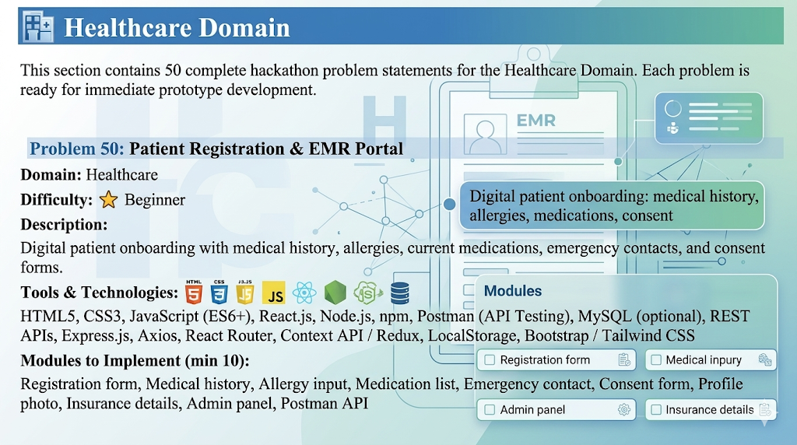

Slide 3
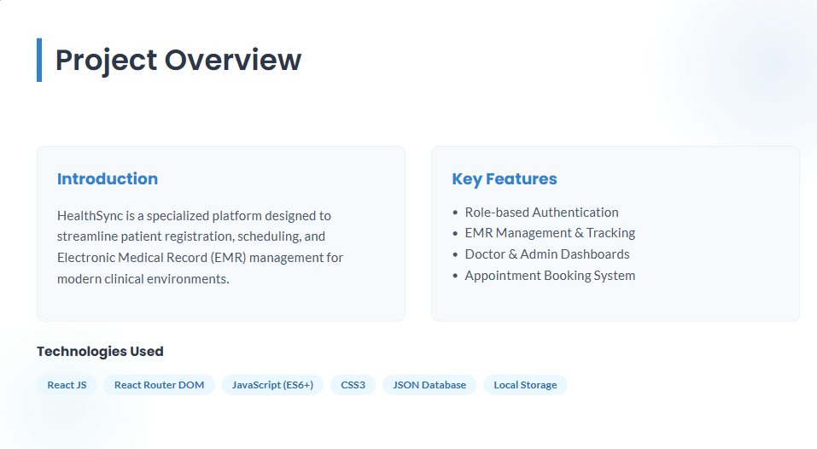

Slide 4
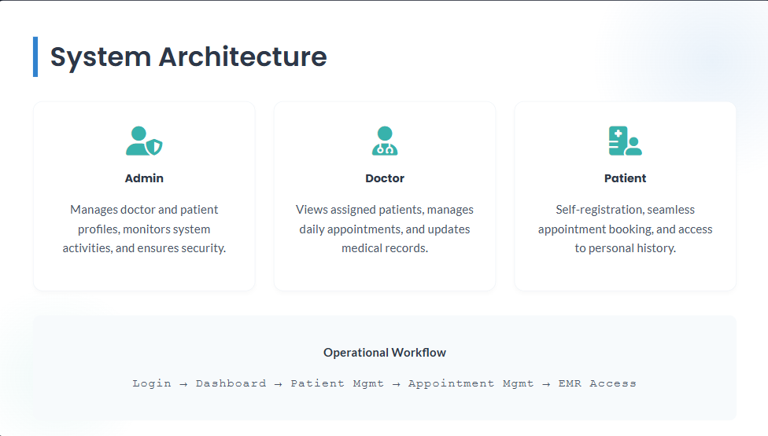

Slide 5
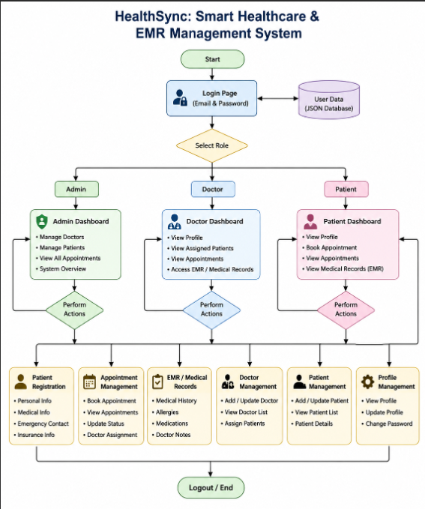

Slide 6
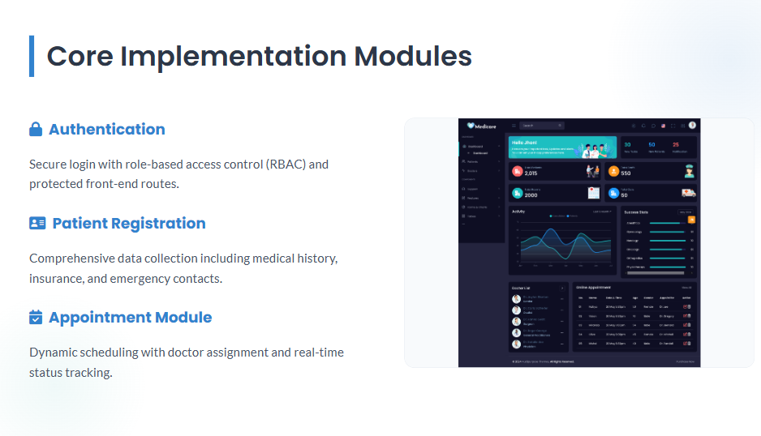

Slide 7


Slide 8
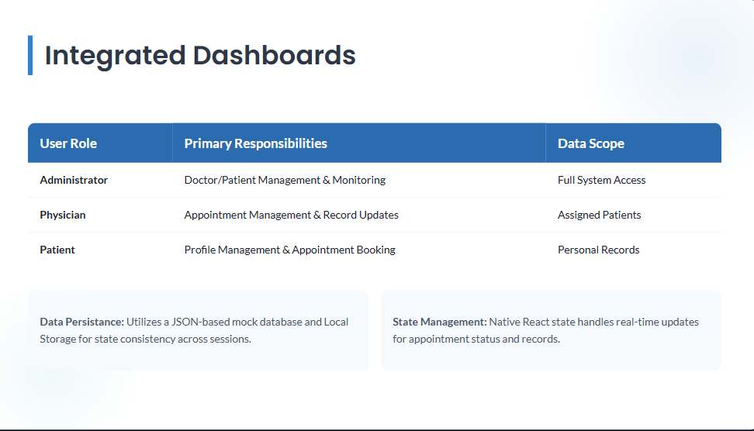

Slide 9
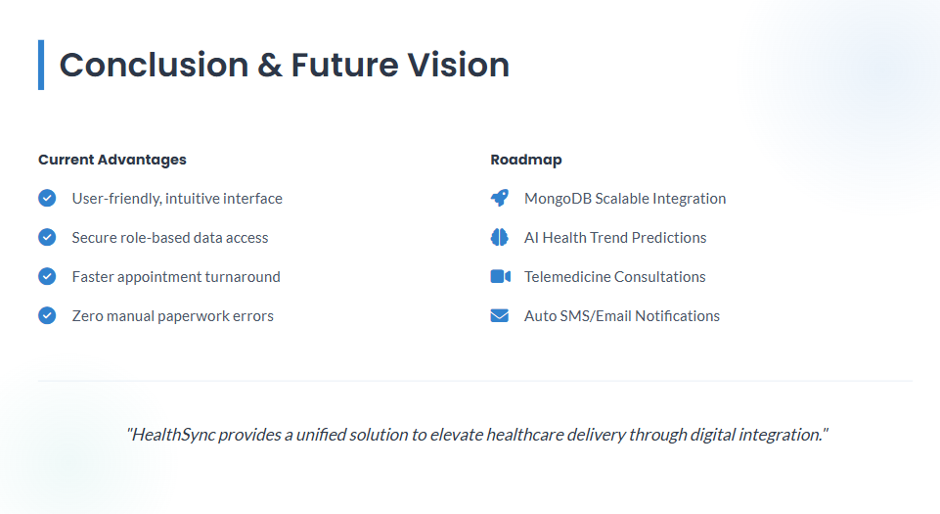

Slide 10
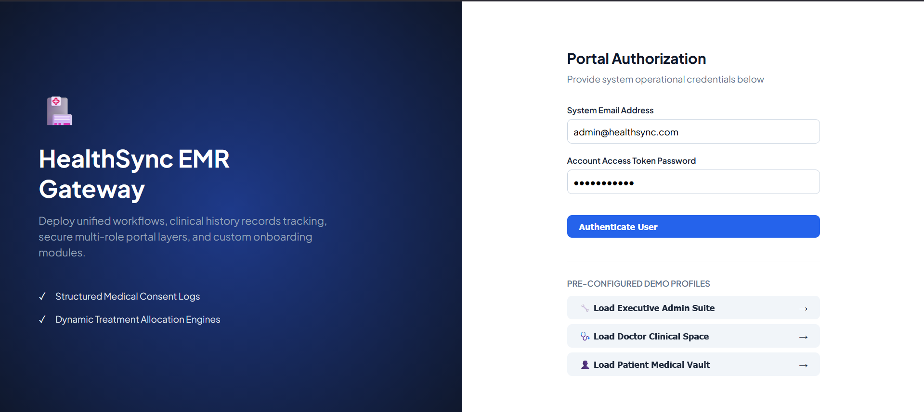
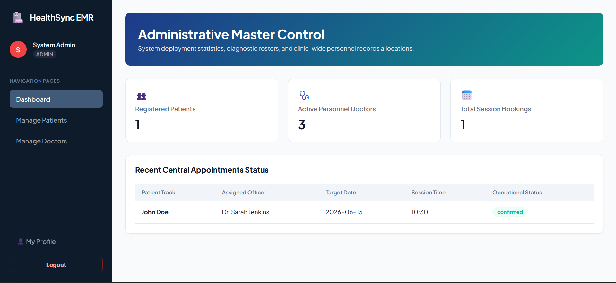
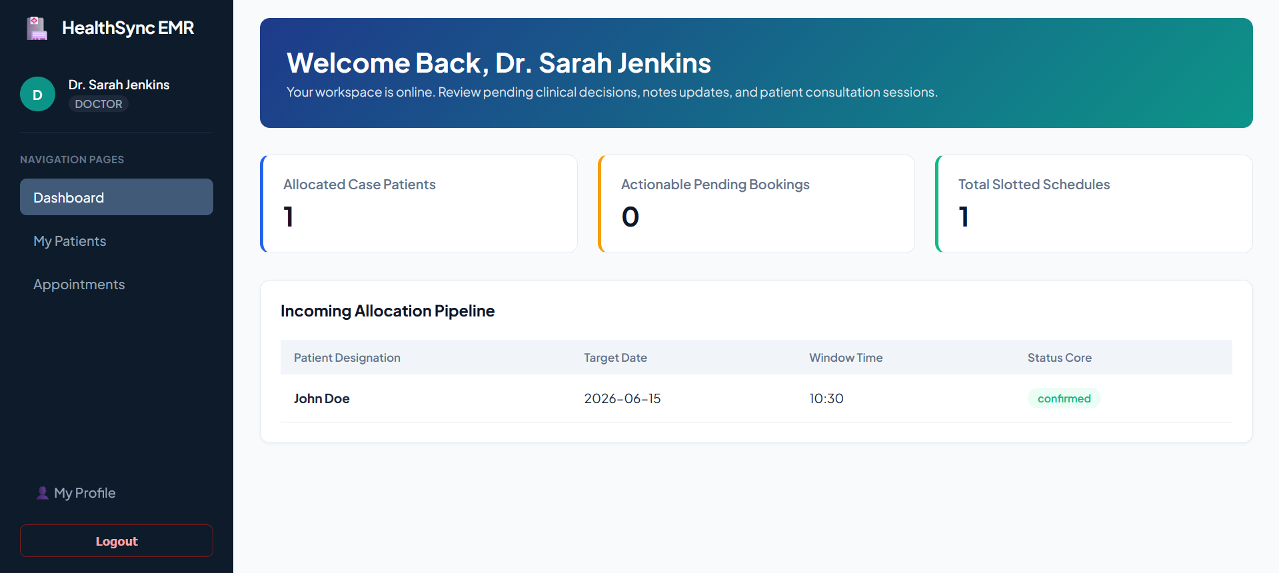
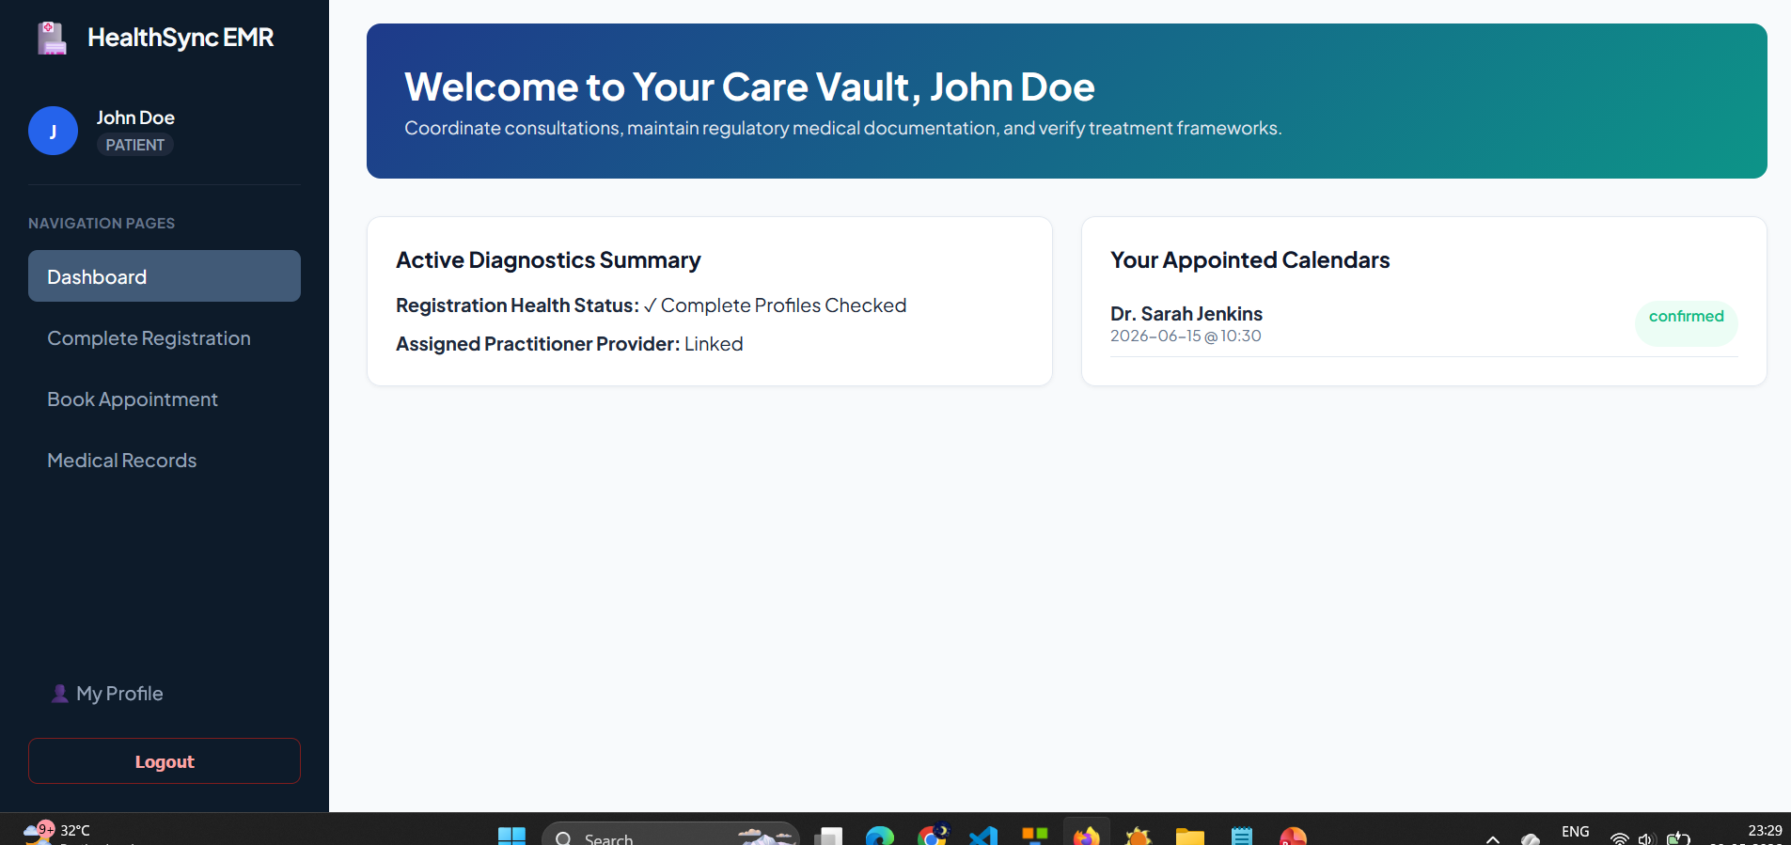
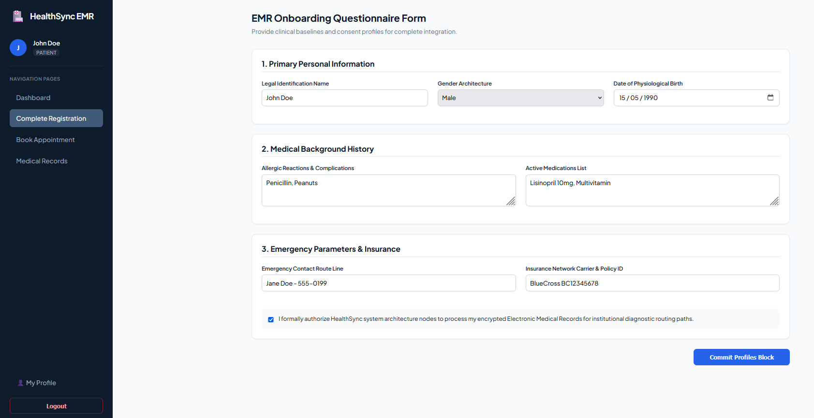
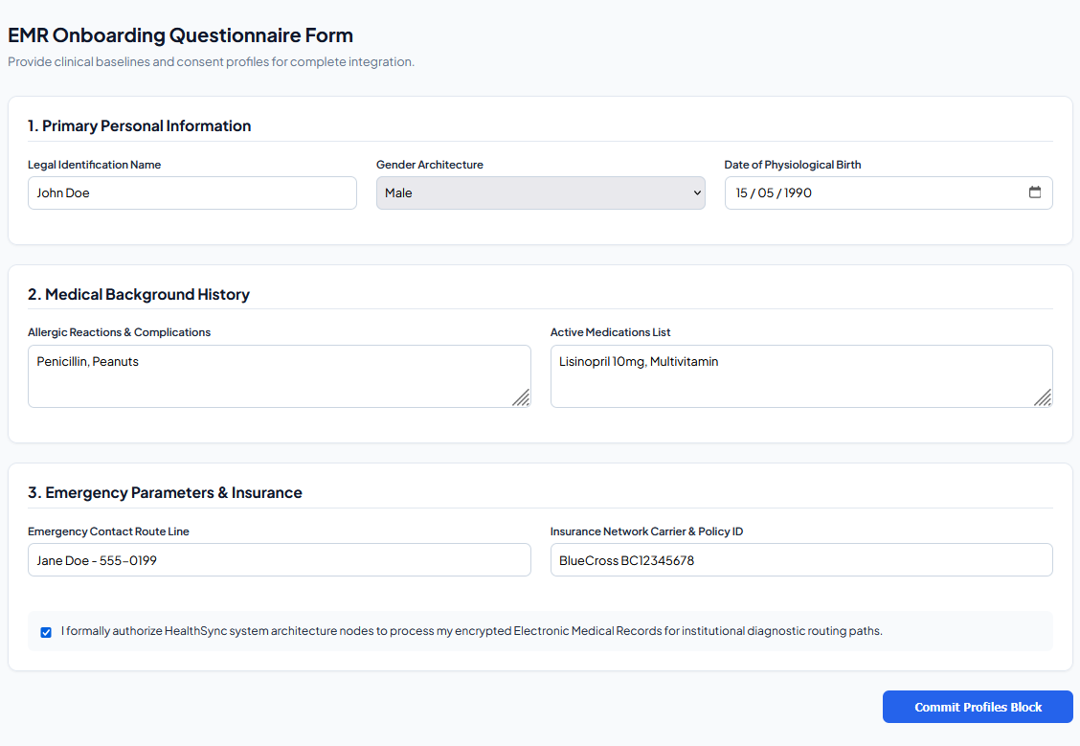
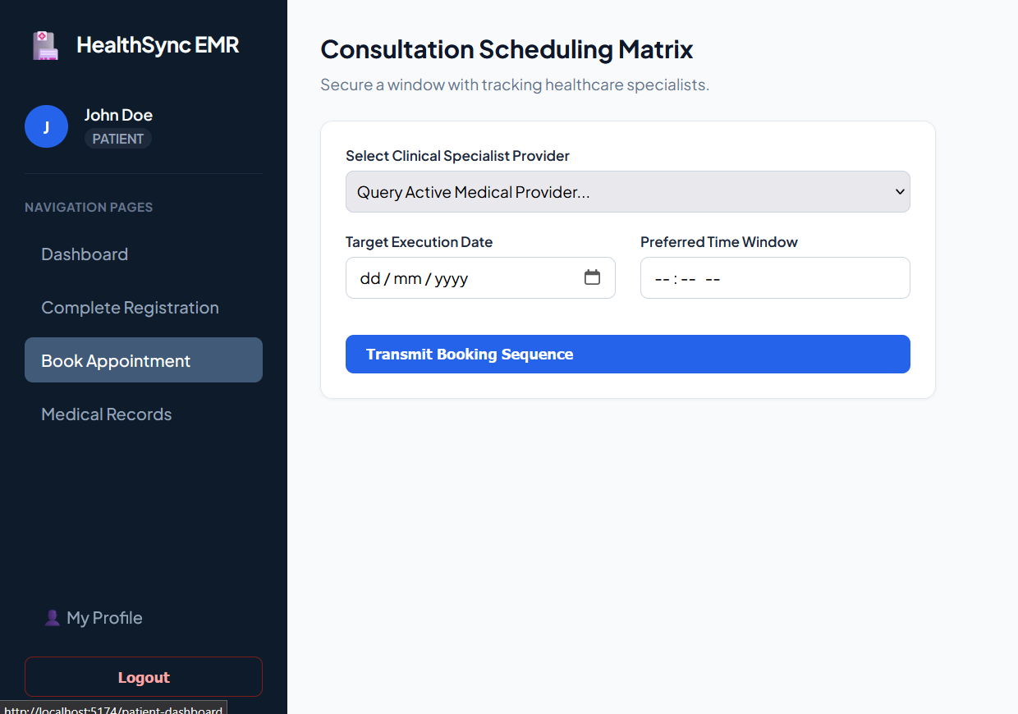
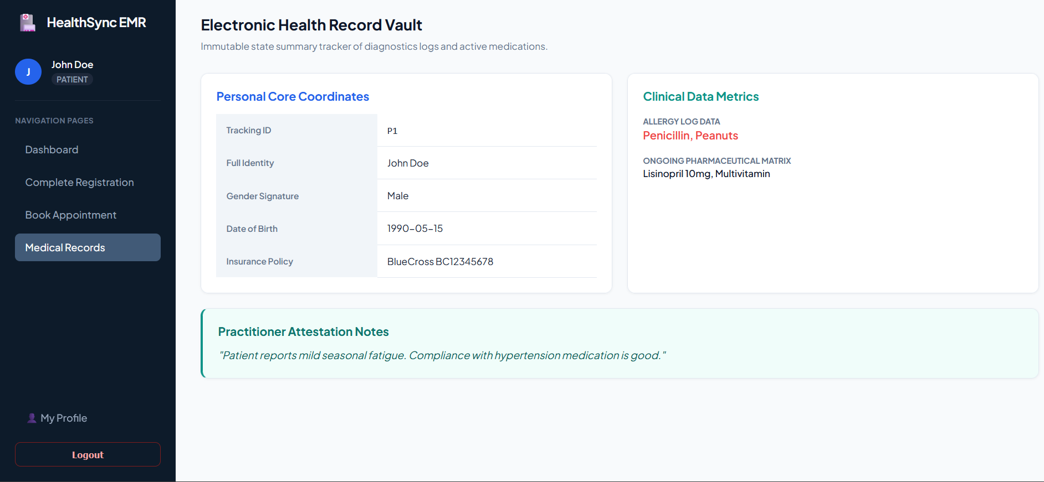
Login page
Patient Dashboard
Admin Dashboard
Doctor Dashboard
Book Appointment
Registration Page
Registration Page
Medical Record

Slide 11


